Slide 1
Action.ml
Team 27 - Jumpball, Jumpshot, Three-point prediction
Gokulan | Raghav | Nithish | Srihari

Slide 2
Documentation URL
https://tinyurl.com/y42mtrna

Slide 3
Problem Statement - Image Classification
WHY?
Real-time analysis to viewers
Easy and Efficient Detection of fouls
How can we bring in better players?
Analysis of player’s body positions

Slide 4
Problem Statement - Crunching Numbers
Three point decision: Validate players based on stats
Jump Ball Win percentage:
Statistic | Criteria for Best | Criteria for Worst
3PT Attempt Rate | > = 0.500 | > = 0.333
3PT FG % | > = 0.375 | < = 0.333
3PT FG Attempts per Game | > = 4 | > = 4
Minutes Per Game | > = 15 | > = 15
Player | Team | JB Wins | JB Att | JB%
Camby | DEN | 33 | 44 | 75%
Dampier | DAL | 33 | 46 | 71%

Slide 5
Data Preprocessing
Data Shuffling
Data Sampling - equi-weighted class distribution of data
Choose few frames before and after a sequence of True labels are chosen along with the True sequences. This gives a good continuity between images we have thus enabling the CNNs to extract more meaningful features from the images to classify False and True images.

Slide 6
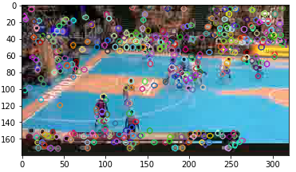
Feature Extraction (1/4)
SIFT (Scale Invariant Feature Transform)

Slide 7
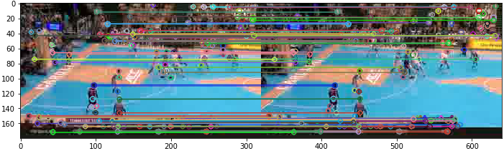
Feature Extraction (2/4)
SIFT (Scale Invariant Feature Transform) - (contd)

Slide 8
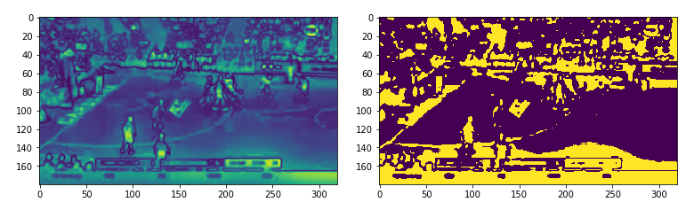
Feature Extraction (3/4)
Saliency Detection

Slide 9
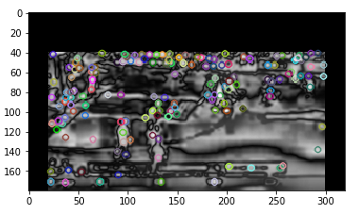
Feature Extraction (4/4)
Smoothing Images
Image Occlusion
Histogram Equalization

Slide 10
Why Xception?
Depth-wise separable convolutions
Reordering of Pointwise and Spatial convolutions
Non Linearity of intermediate layers
Model params (inference time) v/s accuracy trade-off

Slide 11
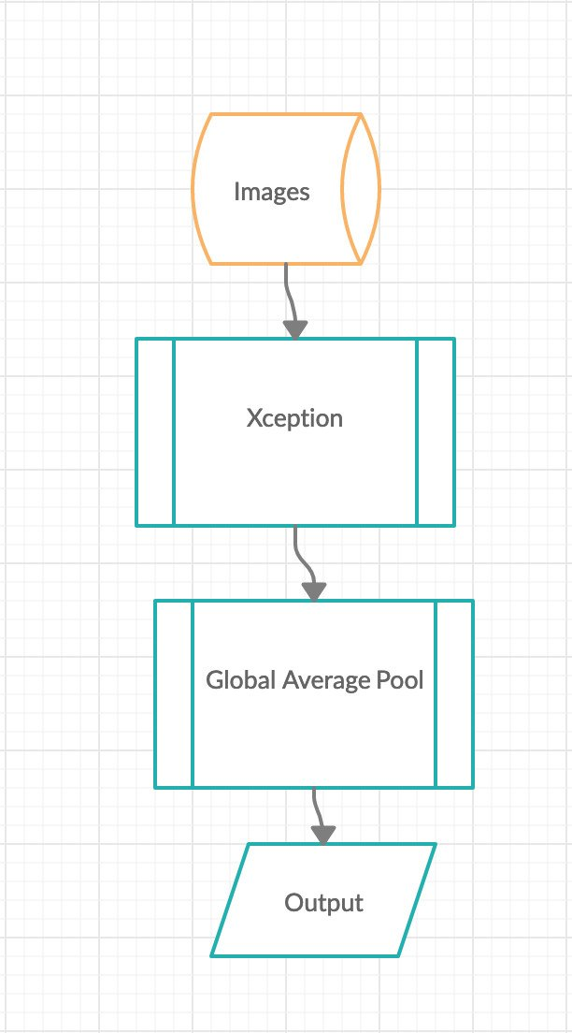
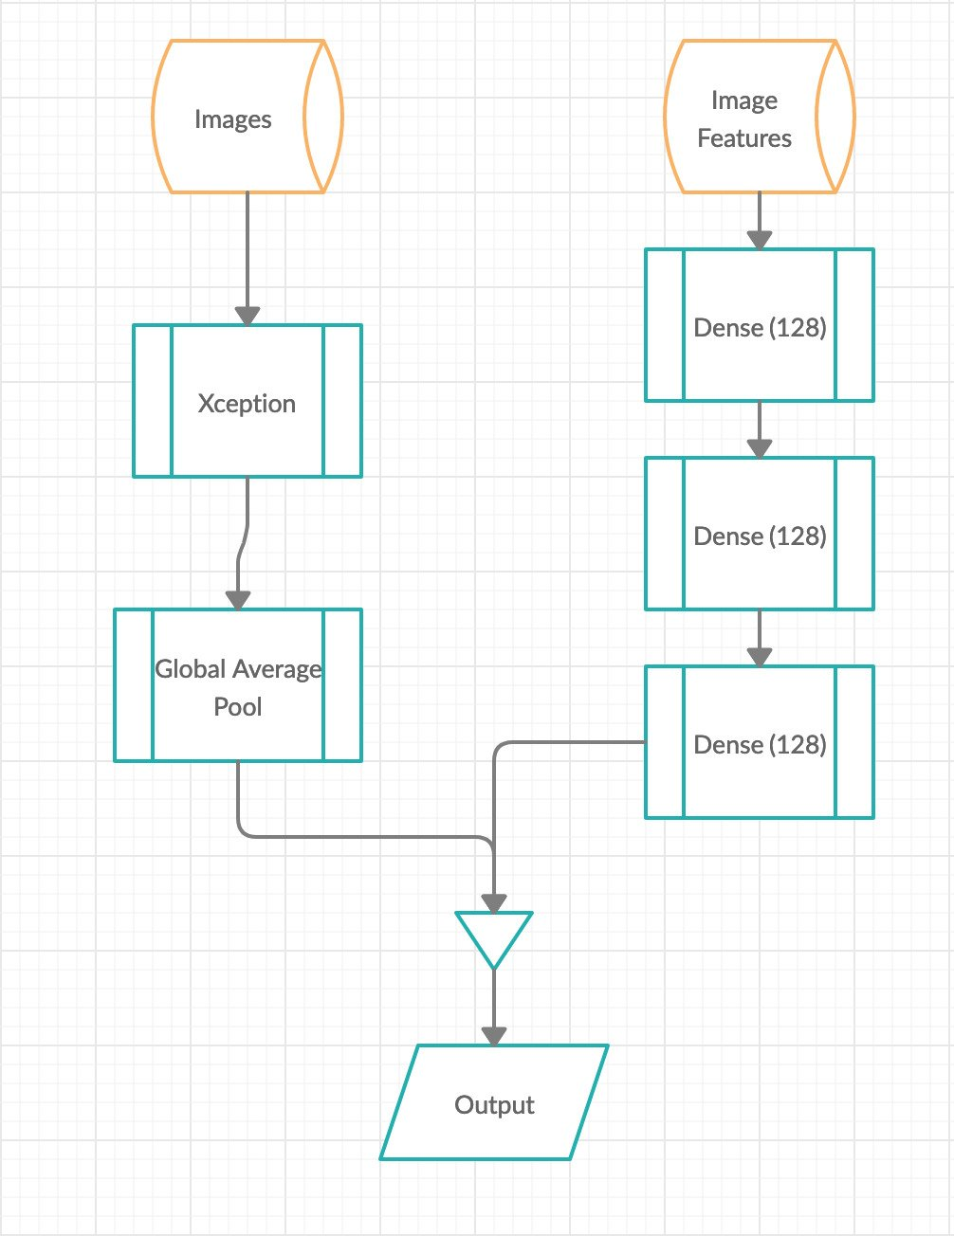
How did we architect our Deep learning Architecture

Slide 12
Model Performance
30
22M
99%
MINUTES TO TRAIN
NUMBER OF PARAMETERS
TESTING ACCURACY
In the CNN
Accurate without overfitting

Slide 13
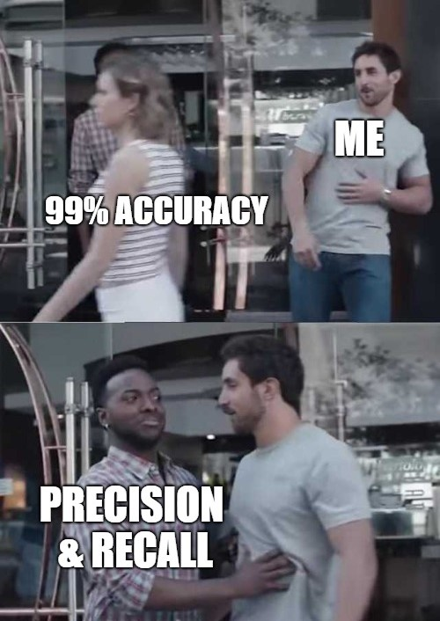
Accuracy
Precision | Recall
Jump ball
Validation Accuracy - 0.99
 | True | False
True | 240 | 2
False | 5 | 237

Slide 14
Accuracy (Precision and Recall) Cont.
Jump Shot
Validation Accuracy - 0.98
Three Point
Validation Accuracy - 0.97
 | True | False
True | 365 | 0
False | 18 | 481
 | True | False
True | 936 | 4
False | 46 | 1172

Slide 15
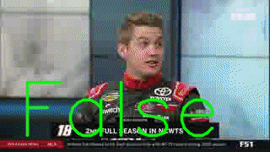
Talk is boring... Show me the y_pred !!!
Jumpball scenario

Slide 16
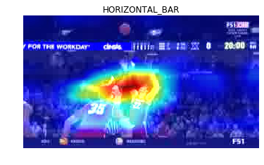
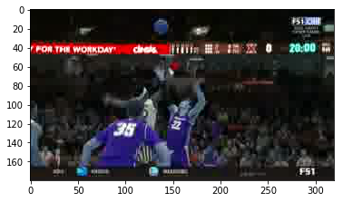
Jumpball Scenario
Original Image vs Heatmap

Slide 17
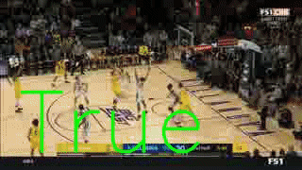
Results (2/3)
Jumpshot scenario

Slide 18
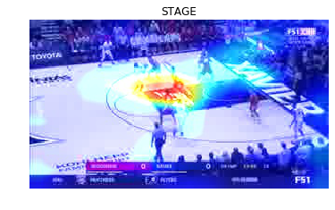
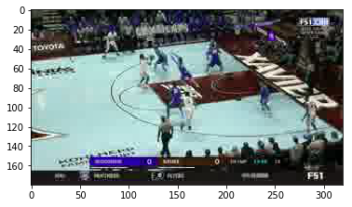
Jumpshot Scenario
Original Image vs Heatmap

Slide 19
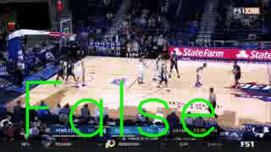
Results (3/3)
Three point scenario

Slide 20
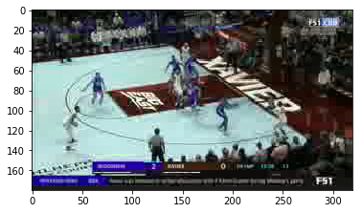
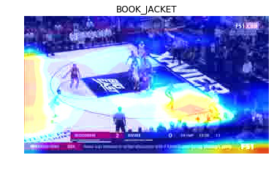
Three point scenario
Original Image vs Heatmap

Slide 21
Challenges we faced
Biased Training data - preprocessing
Feature Extraction
Model Selection
Accuracy, Inference time trade-off

Slide 22
Thank You

